Slide 2
Contents
Introduction
What is Electricity price prediction.
Objectives
General Challenges
Input/Output and Sample Dataset.
Methods
Existing approaches and their Limitations
Understanding Dataset and challanges
Our approach
Results
Conclusion

Slide 3
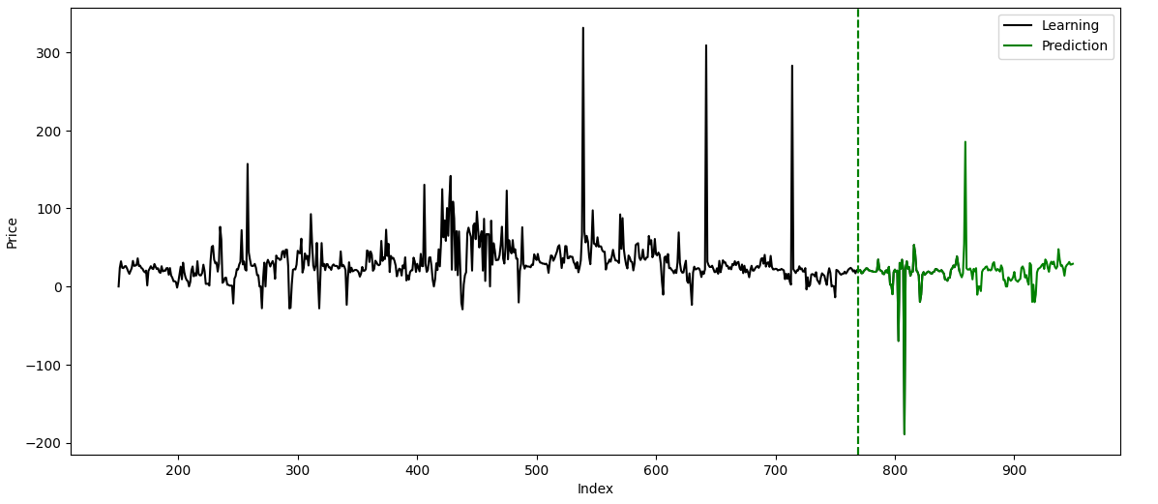
Introduction
What is Electricity price prediction?
Electricity price prediction is forecasting the cost of electricity over a future time period. Generally sorted as follows, Short-Term Forecasting (Minutes to days), Medium-Term Forecasting (usually months), Long-Term Forecasting(Sometimes years).
Sample instance of prediction

Slide 4
Problem statement
Electricity prices are highly volatile and influenced by various factors such as demand, supply, weather, and market dynamics, making accurate prediction is challenging and necessary.
Goal/Objective of this project.
Want to predict hourly electricity price more accurately, decreasing the error values.

Slide 5
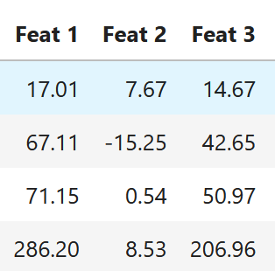
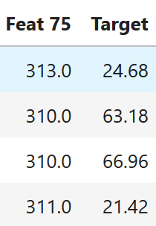
Impact of Electricity price prediction.
Energy Companies: Optimizes generation scheduling and bidding strategies, enhancing operational efficiency.
Consumers: Enables cost-effective energy usage and participation in demand response programs.
Sample input/output.
Input usually contains various features that influence electricity price, represented as a vector of size K Ex: (Feature 1, Feature 2 ….. Feature K)
Output is a single predicted value or a sequence of values representing future electricity prices
Ex: Price (in $)
Sample Dataset

Slide 6
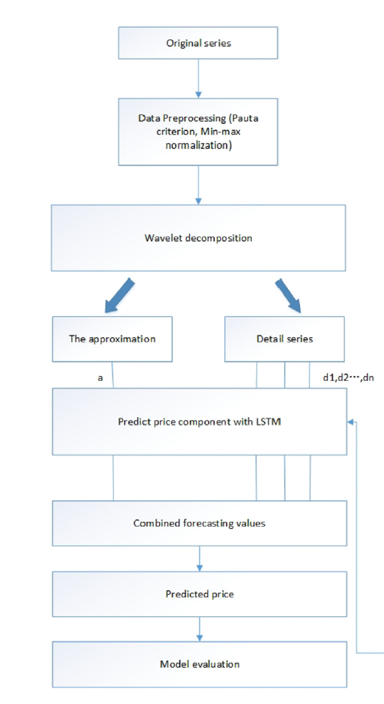
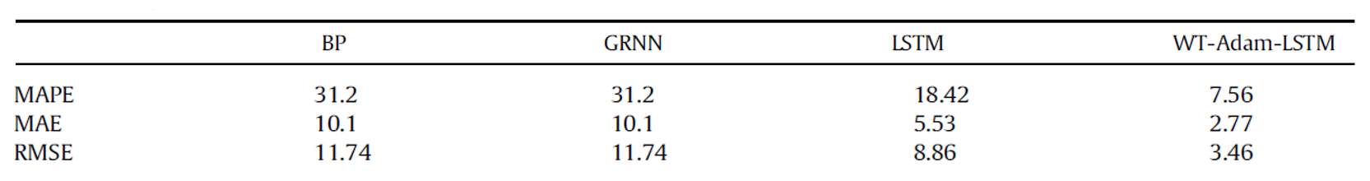
Existing Methodology
Method-1
[1] Electricity price prediction based on hybrid model of Adam optimized LSTM neural network and wavelet transform
Wavelet Decomposition: Transforming the price series into smoother sub-series for better pattern recognition.
Adam-Optimized LSTM: Training an LSTM network to capture sequential patterns and improve prediction accuracy using the Adam optimizer.
Model Evaluation: Using metrics like Mean Absolute Percentage Error (MAPE) and Root Mean Squared Error (RMSE) to validate performance.

Slide 7
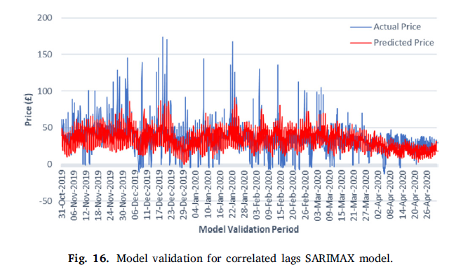
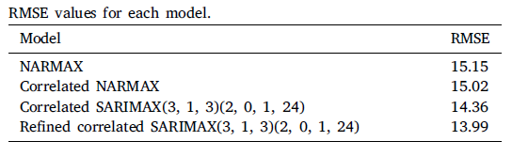
Method-2
[2] Hourly electricity price forecasting with NARMAX
This methodology of this NARMAX model (Nonlinear AutoRegressive Moving Average model with eXogenous inputs) for electricity price prediction involves:
Data Preprocessing: Collecting and merging data from energy-related factors like electricity demand, generation, and weather, followed by averaging non-hourly data.
Peak Lag Identification: Using autocorrelation analysis to identify key lagged terms from input variables that influence electricity prices (e.g., previous day or hourly lags).
NARMAX Modeling: Building a predictive model by incorporating significant lag factors and refining the structure through iterative removal of redundant terms.

Slide 8
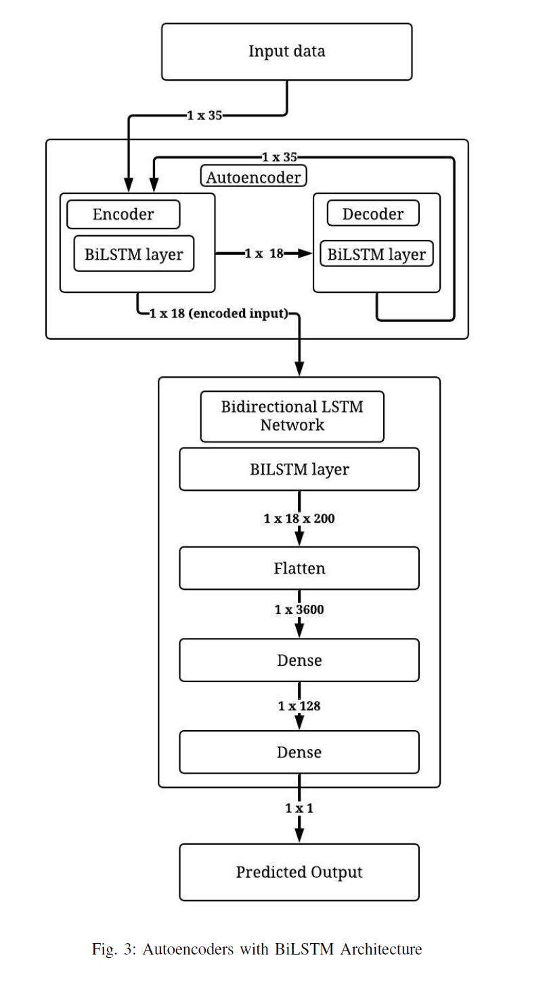
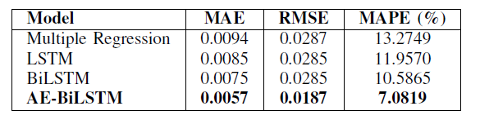
Method-3 (Base Paper)
[3] Real-Time Energy Price Forecasting using BiLSTM-Autoencoder Deep Learning Model
Feature Selection:
From 75 input features, significant ones are selected based on Pearson correlation analysis, narrowing it down to 35 relevant features (e.g., historical prices, demand, and generation).
Preprocessing for Model Training:
Negative values in the price data are converted to positive integers.
Data is normalized using logarithmic functions to facilitate model training.

Slide 9
Gaps/Limitations of current work
The current feature selection may overlook complex relationships or fail to capture all relevant predictors.
The current models employed for electricity price prediction are highly complex
Require extensive computational resources and prolonged training times.
Dataset Understanding
Derived from the New York Independent System Operator (NYISO)
Comprises 75 input variables, including historical electricity prices, load demand data from various sources.
Contains 70128 tuples.

Slide 10
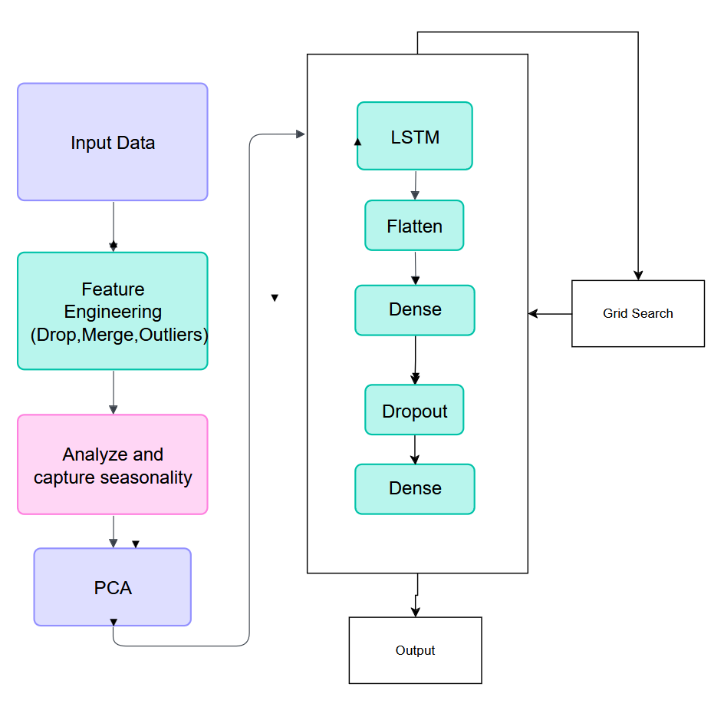
Our Approach
Implementation
Preprocessing: Clean input data (drop, merge, handle outliers).
Feature Reduction: Capture seasonality and apply PCA.
Modeling: Train LSTM with Dense and Dropout layers.
Optimization: Use Grid Search for tuning and generate output.

Slide 11
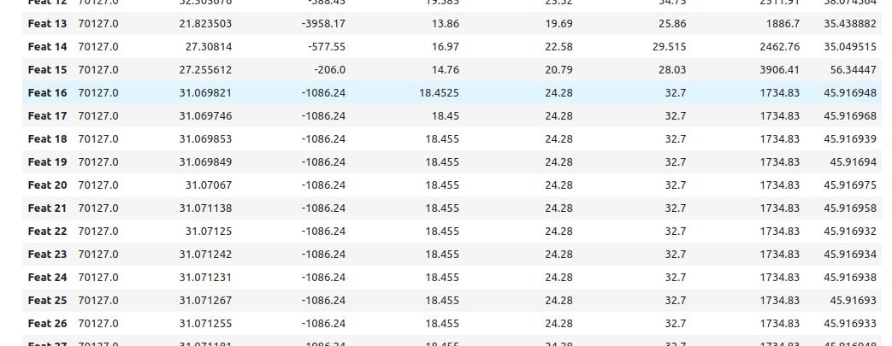
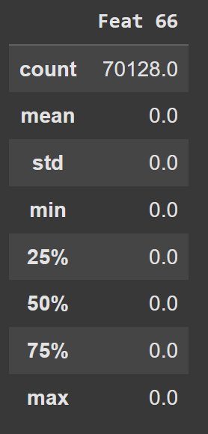
Feature understanding
The dataset contains several lagged features, which may increase the model complexity without improving its performance.
Many features exhibit high inter-correlation, potentially introducing multicollinearity into the model.
Feature 66 info
Identification of Lagged Features

Slide 12
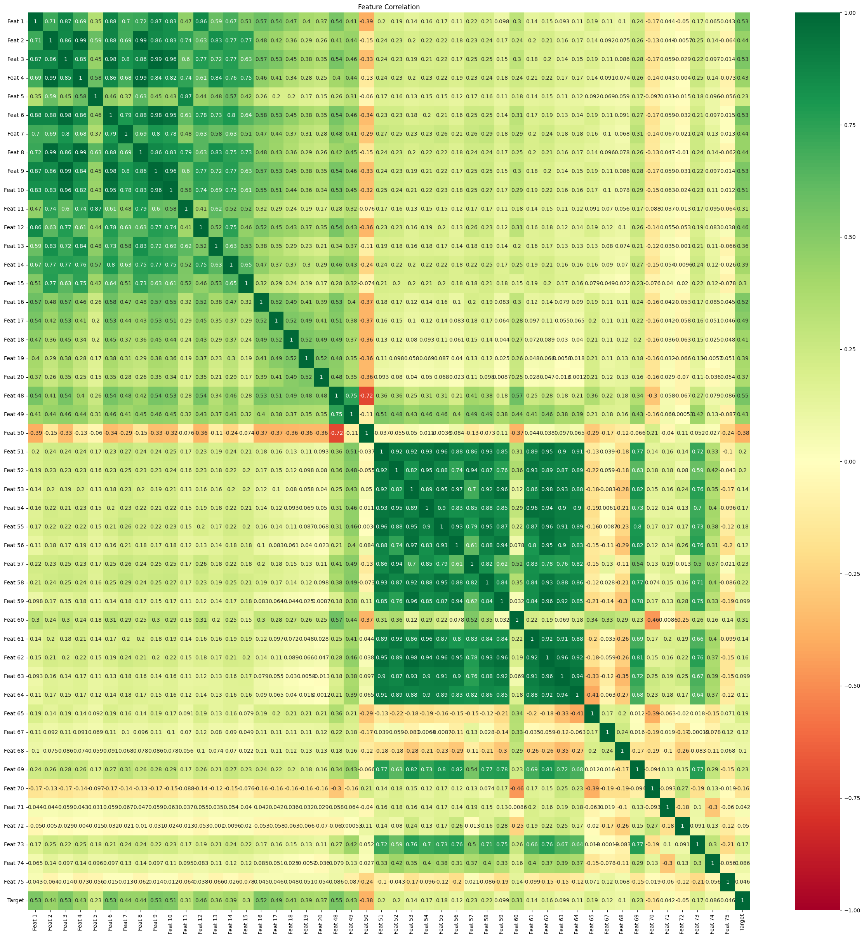
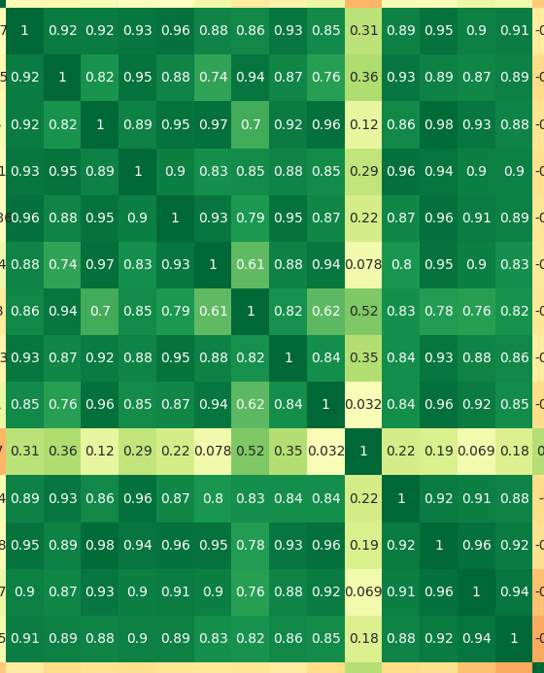
Preprocessing (Drop and Merge)
We drop Feat 66 and most lagged features except first 5 as it gave best accuracy
We merge the features that have high correlation between themselves, helps in reducing dimensionality while retaining most relevant information (We do it multiple steps so we can extract multiple combined features)
Zoomed in Cluster for Correlation

Slide 13
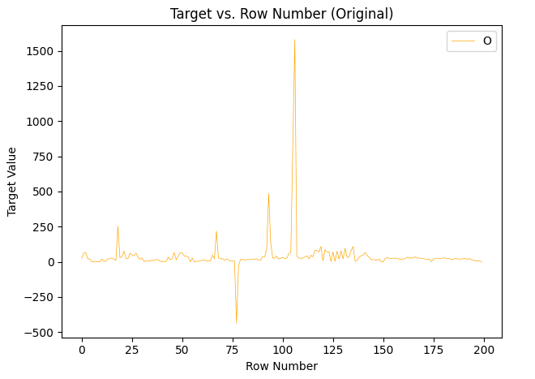
Outlier detection and handling
Outliers are data points that deviate significantly from the rest of the dataset.
Since our dataset has quality data, we only want to say a point is outlier if it is on an extreme end.
Identifying and handling outliers is essential as they can distort statistical analyses and negatively impact model performance.

Slide 14
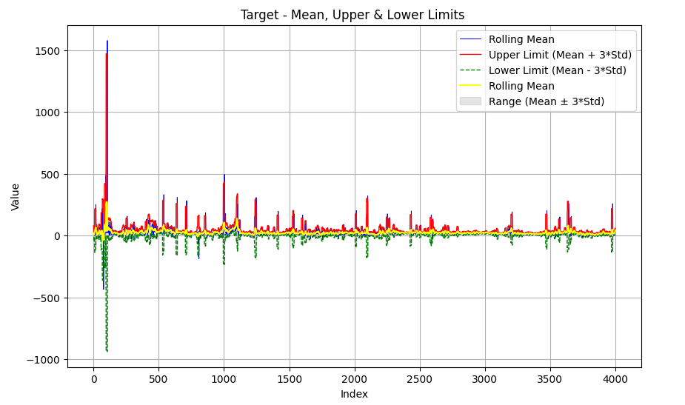
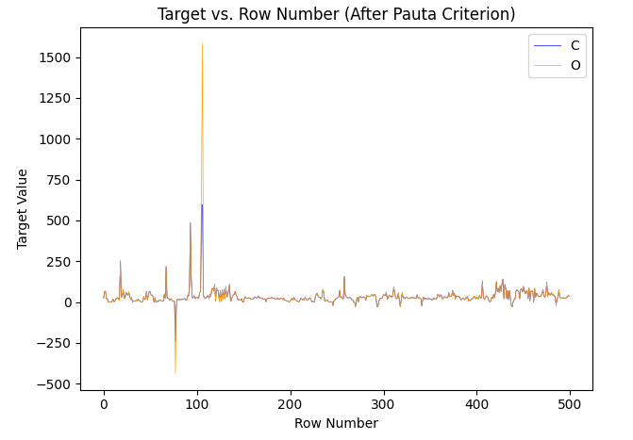
Outlier detection and handling
We use the 3-sigma rule (Pauta criterion) to identify outliers
We replace the identified outliers with mean of local window (neighborhood)
Windowing helps us deal with seasonal highs and lows, making data less prone to be detected as outlier as datapoints in the window are used as comparison.
For example if points are [150, 152, 148, 151, 149, 147, 600], then 600 is not an outlier.

Slide 15
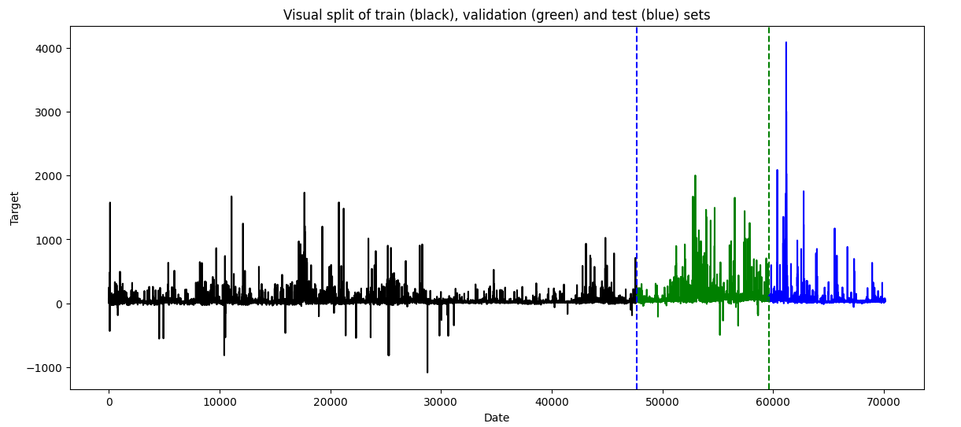
PCA & Data Splits
We applied PCA to reduce the dataset's dimensionality while retaining 95% of the variance.
The process involves scaling the data (using MinMaxScaler) before performing PCA to ensure uniformity.(Makes training easier)
We split the dataset into first 75% test , 10% validation, 15% test sets as follows

Slide 16
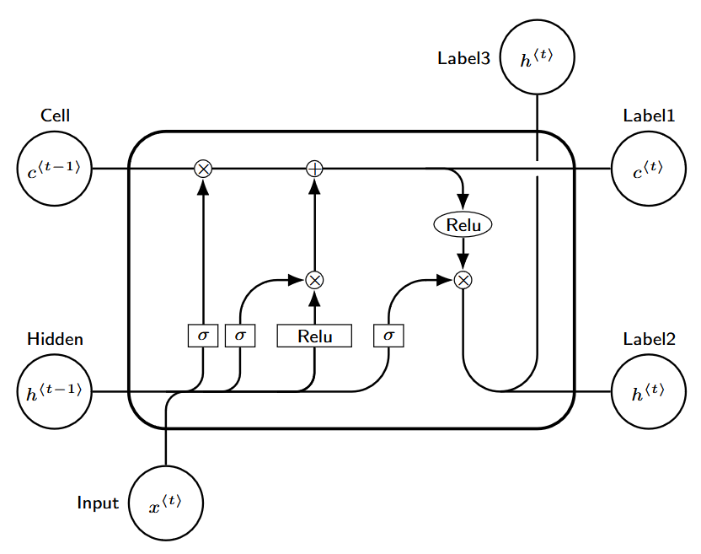
LSTM model
Architecture
A sequential LSTM model is defined with the following layers:
LSTM Layer: Captures temporal dependencies with 128 units, using ReLU activation.
Flatten Layer: Flattens the output from the LSTM layer.
Dense Layer: Fully connected layer with 128 units and ReLU activation.
Dropout Layer: Includes a 10% dropout rate to prevent overfitting.
Output Layer: Final dense layer with a single unit for predictions.

Slide 17
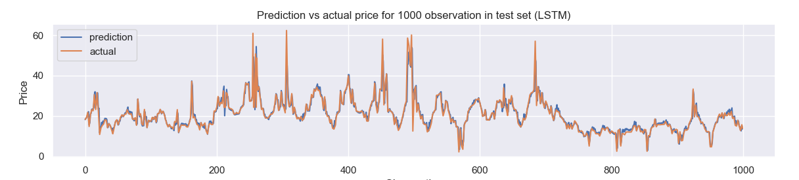
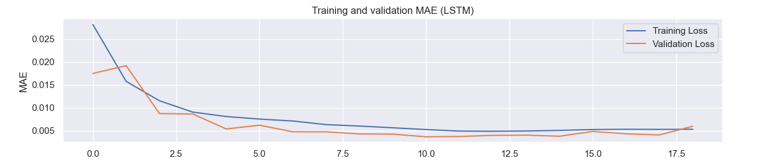
Results:
Error Metrics of our Model :
MAE: 1.356
RMSE: 4.065
MAPE: 6.460

Slide 18
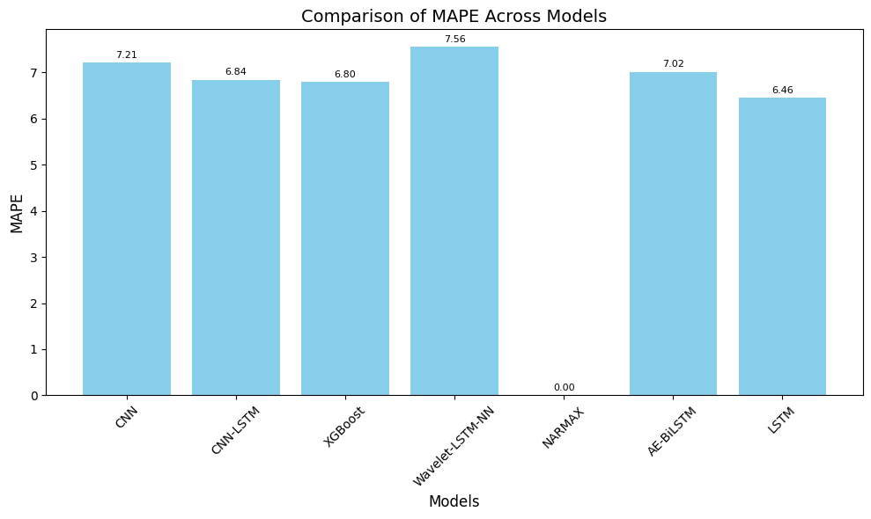
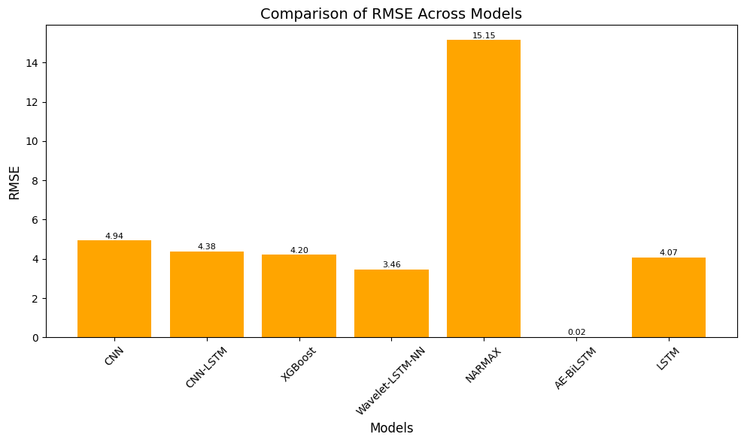
Model Comparison:
Model | MAE | RMSE | MAPE
CNN | 1.591 | 4.939 | 7.211
CNN-LSTM | 1.501 | 4.379 | 6.844
XGBoost | 1.476 | 4.203 | 6.798
Wavelet-LSTM-NN | 2.77 | 3.46 | 7.56
NARMAX | - | 15.15 | -
AE-BiLSTM | 0.0057 | 0.0187 | 7.0189
LSTM | 1.356 | 4.065 | 6.46

Slide 19
Possible Future Work:
Although we are able to achieve good results with simple LSTM model , there can be hybrid model that can perform better with our models preprocessing.
Can add explainable AI techniques to interpret the model's predictions, making the results more transparent and knowing impact of each step.

Slide 20
References
[1] C. McHugh, S. Coleman, and D. Kerr, “Hourly electricity price forecasting with narmax,” Machine Learning with Applications, vol. 9, p. 100383, 2022. [Online]. Available: https://www.sciencedirect.com/science/article/pii/S266682702200069X
[2] Z. Chang, Y. Zhang, and W. Chen, “Electricity price prediction basedon hybrid model of adam optimized lstm neural network and wavelet transform,” Energy, vol. 187, p. 115804, 2019. [Online]. Available: https://www.sciencedirect.com/science/article/pii/S0360544219314768
[3] S. Namani, M. A. Amin, M. O. Miah, A. A. A. Khan, M. F. Kabir,and M. H. Ullah, “Real-time energy price forecasting using bilstm-autoencoder deep learning model,” IEEE Transactions on Power Systems, pp. 1–10, 2024.

